Slide 1


The CUAHSI Community Hydrologic Information System
CUAHSI
HIS
Sharing hydrologic data
http://his.cuahsi.org/
Jeffery S. Horsburgh
Utah Water Research Laboratory
Utah State University
Support
EAR 0622374

Slide 2
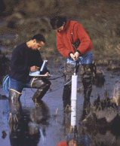
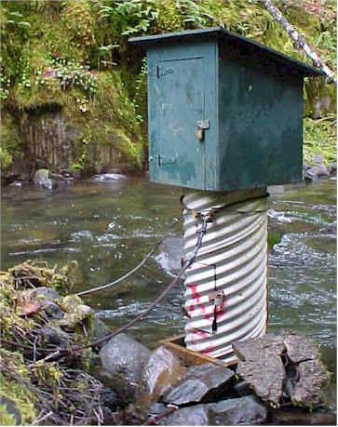
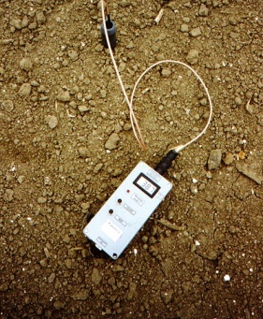
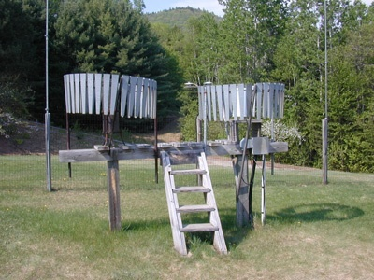
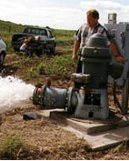
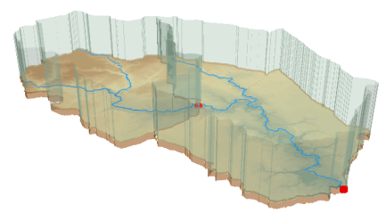
Hydrologic Data Challenges
Water quality
Water quantity
From dispersed federal agencies
From investigators collected for different purposes
Different formats
Points
Lines
Polygons
Fields
Time Series
Rainfall and Meteorology
Soil water
Data Heterogeneity
Groundwater
The way that data is organized can enhance or inhibit the analysis that can be done
GIS

Slide 3
CUAHSI HIS
The CUAHSI Hydrologic Information System (HIS) is an internet based system to support the sharing of hydrologic data. It is comprised of hydrologic databases and servers connected through web services as well as software for data publication, discovery and access.
Data Discovery and Integration platform
HIS Central
Like search portals Google, Yahoo, Bing
Metadata Services
Metadata Search
Service registration
Service and data theme metadata
Catalog harvesting
Data carts
HydroServer
Data Services
HydroDesktop
Data Publication platform
Water Data Services
Data Synthesis and Research platform
Spatial Data Services
Like web servers
Like HTML
Like browsers

Slide 4
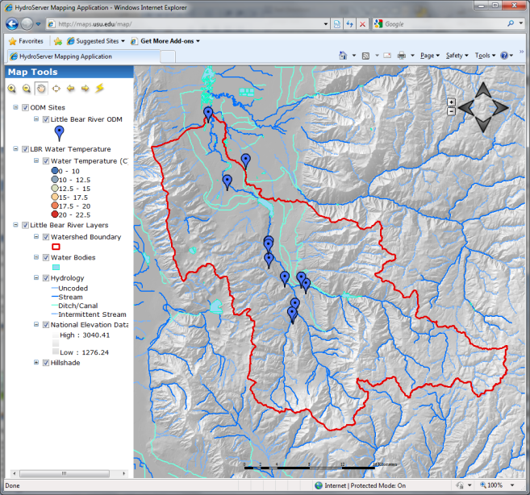

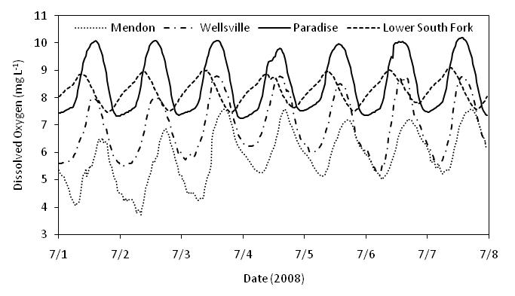

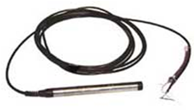
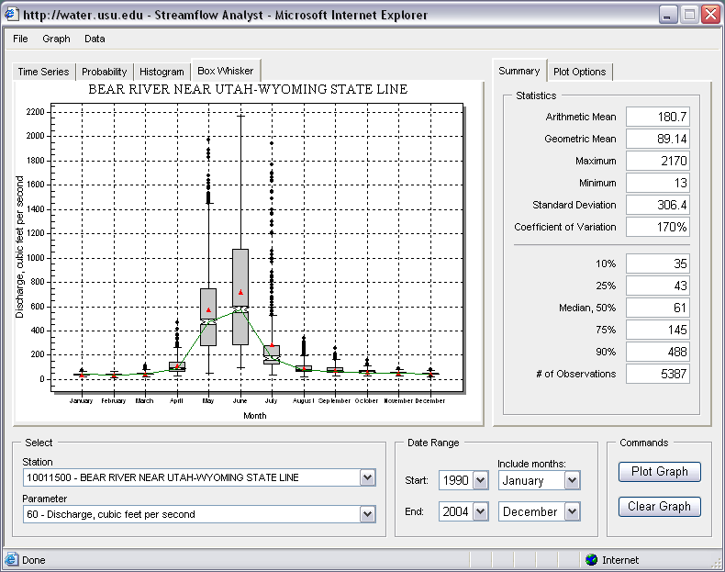
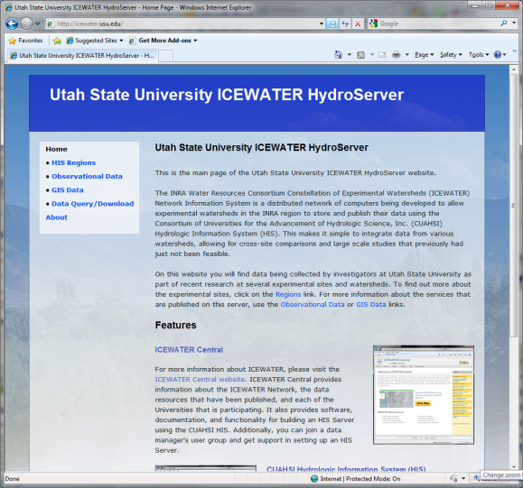
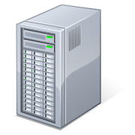
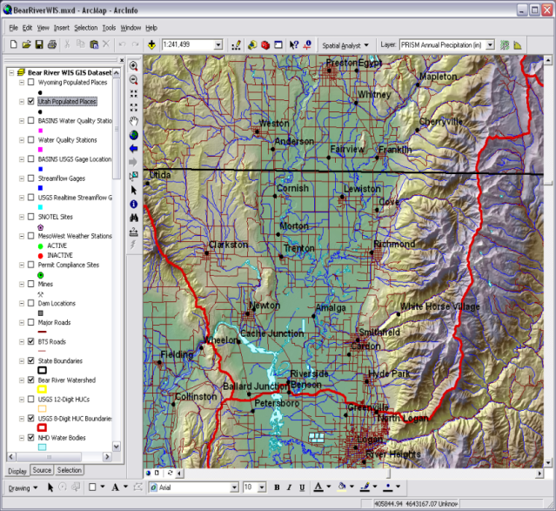
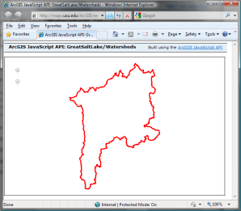
HydroServer – Data Publication
Point Observations Data
Internet Applications
Ongoing Data Collection
Historical Data Files
ODM Database
GetSites
GetSiteInfo
GetVariableInfo
GetValues
GIS Data
WaterML
WaterOneFlow
Web Service
OGC Spatial Data Service from ArcGIS Server
Data presentation, visualization, and analysis through Internet enabled applications

Slide 5
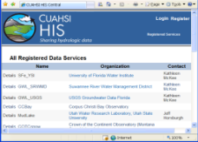
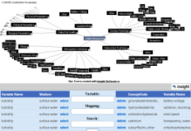
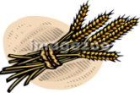

HydroCatalog
Service Registry
Hydrotagger
Search over data services from multiple sources
Supports concept based data discovery
WaterML
Harvester
Water Metadata Catalog
GetSites
GetSiteInfo
GetVariableInfo
GetValues
WaterOneFlow
Web Service
Search Services
CUAHSI Data Server
3rd Party Server
e.g. USGS
Discovery and Access
Hydro
Desktop
http://hiscentral.cuahsi.org

Slide 6
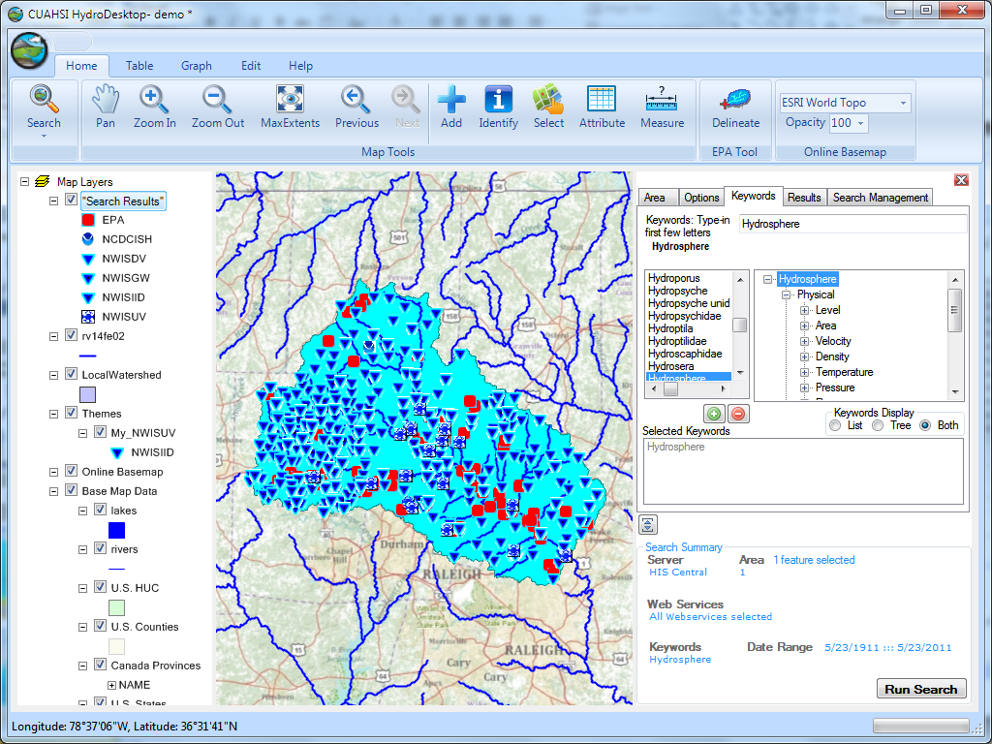
Thematic keyword search
HydroDesktop – Data Access and Analysis
Integration from multiple sources
Search on space and time domain

Slide 7
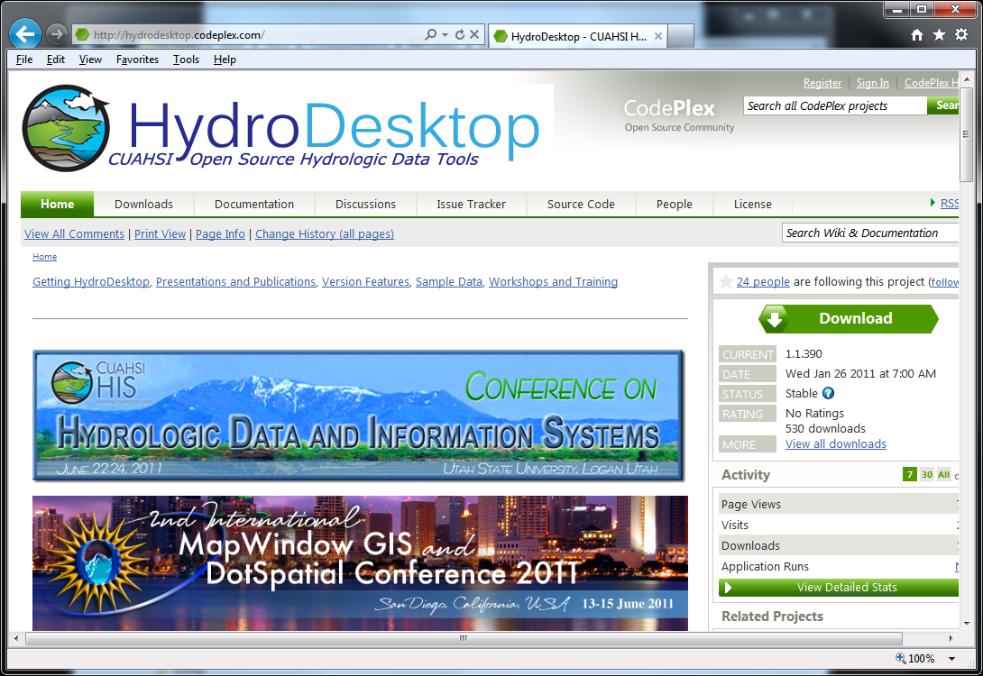
Open Development
http://hydrodesktop.codeplex.com
http://hydroserver.codeplex.com
http://hydrocatalog.codeplex.com

Slide 8
HIS Project Team and Sponsors
University of Texas at Austin – David Maidment, Tim Whiteaker, James Seppi, Fernando Salas, Jingqi Dong, Harish Sangireddy
San Diego Supercomputer Center – Ilya Zaslavsky, David Valentine, Tom Whitenack, Matt Rodriguez
Utah State University – David Tarboton, Jeff Horsburgh, Kim Schreuders, Stephanie Reeder, Edward Wai Tsui, Ravichand Vegiraju, Ketan Patil
University of South Carolina – Jon Goodall, Anthony Castronova
Idaho State University – Dan Ames, Ted Dunsford, Jiří Kadlec, Yang Cao, Dinesh Grover
Drexel University/CUNY – Michael Piasecki
CUAHSI Program Office – Rick Hooper, Yoori Choi, Conrad Matiuk
ESRI – Dean Djokic, Zichuan Ye
CUAHSI
HIS
Sharing hydrologic data
Support
EAR 0622374
http://his.cuahsi.org/

